Slide 1
Main causes of mortality in children under 5 years old
Investigation of the toughest health-related challenges
Notes:
Hello, I represent group X, and our approach for this project was to highlight the toughest health-related challenges that cause mortality in children under 5 years old.
<don’t need to speak this>
Main causes of under 5-year-old child mortality
WHY - None of the other challenges don’t matter if they don’t make it older
Country / Area / Continent analysis *Rasmus
Do some areas have more mortality, why?
Vaccination analysis, does vaccination affect child mortality * Tuomo
Nutrition/ Nutrition breastfeeding analysis * Tuomo
Education analysis
Hygiene (WASH) analysis * Ville
You can come up with your analysis ideas but these are the initial ideas and whose responsibility they are.
Only a 3-minute video, not too much data into the video. You probably don’t need to analyze all of these topics.

Slide 2
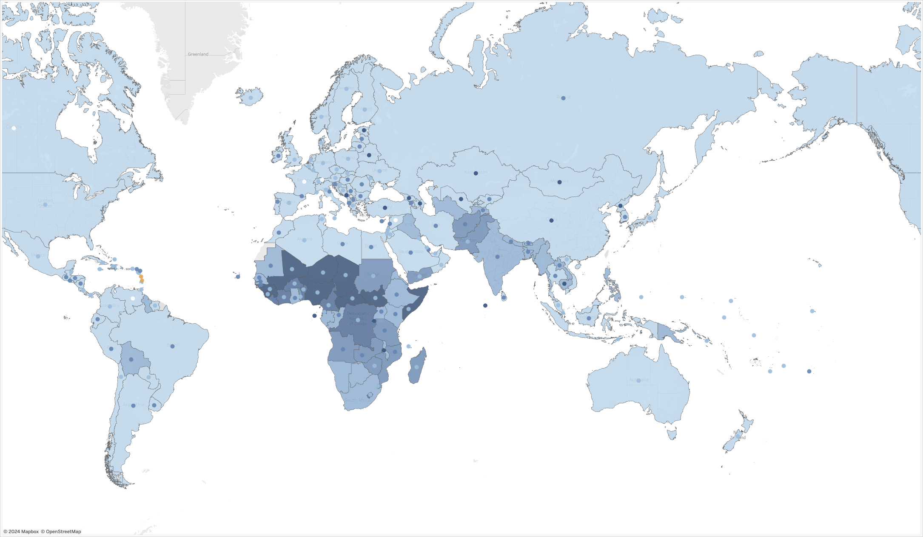
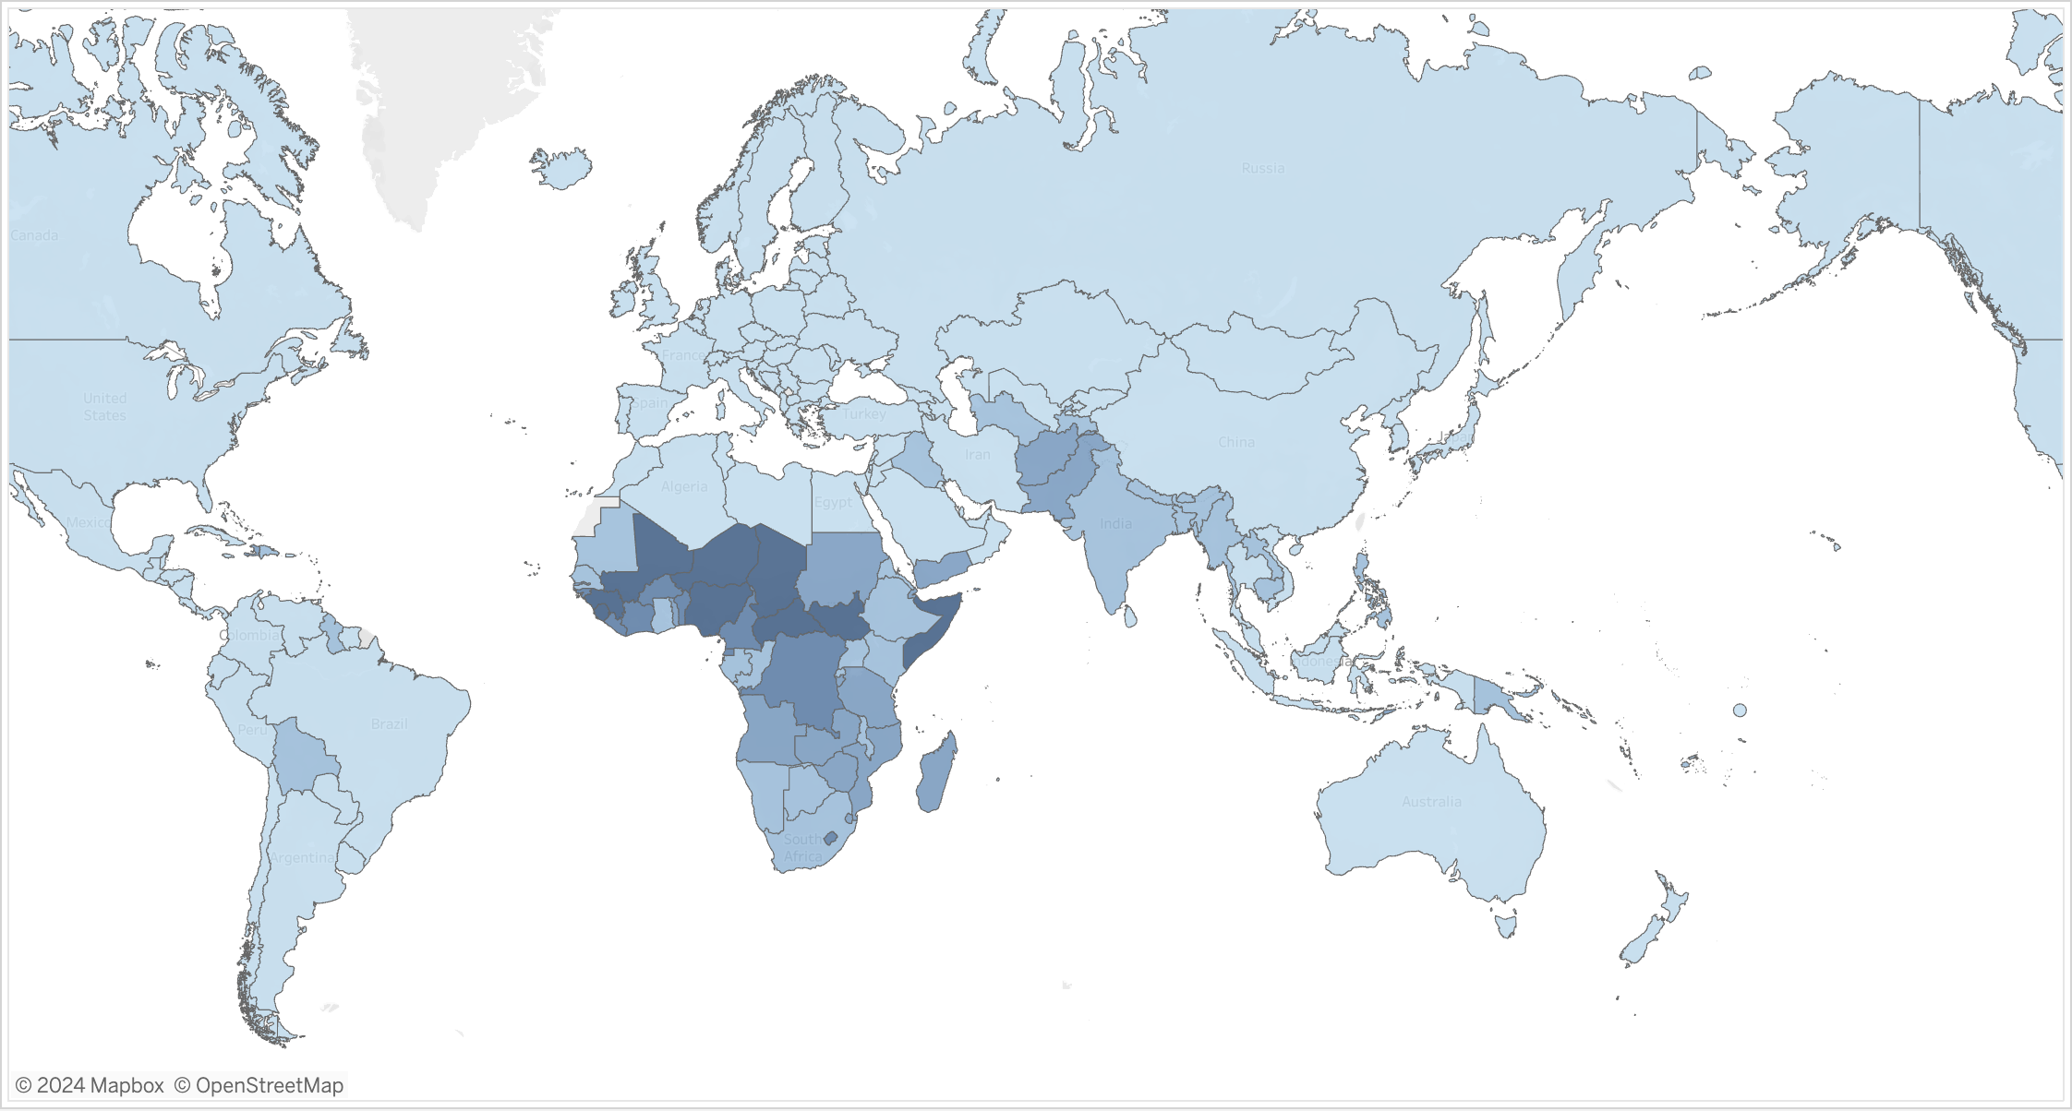
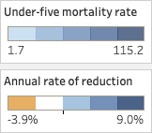
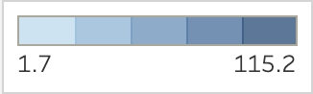
Under-five mortality rate by country in 2021 Focused in Sub-Saharan Africa
Today, under-five mortality rates range between 1.7 and 115.2 cases per 1000 births.
Most countries see relatively low mortality rates, although, there is a clear concentration in Sub-Saharan Africa and to a lesser degree in South Asia as well.
As shown by the colored dots, many countries in these areas have not been able to significantly reduce their mortality rates.
Notes:
Today, most countries experience relatively low child mortality rates. However, as we can be seen from the map, there is a clear concentration of high rates in Sub-Saharan Africa, and to a lesser degree, in South Asia as well. Furthermore, the light-colored dots in these areas tell us that many of these countries have not been able to reduce their child mortality rates significantly over time.

Slide 3
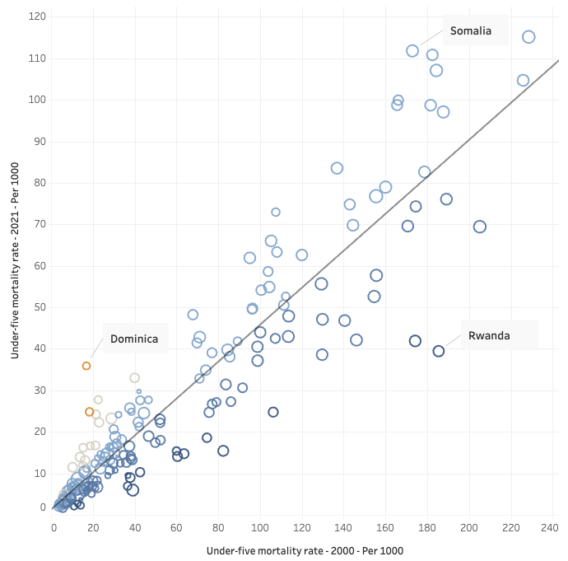
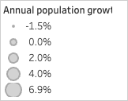
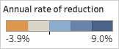
Trends in under-five mortality rates between 2000 and 2021 Some countries have reduced mortality rates significantly more than others
By looking at the plot, it is clear that most countries with high under-five mortality rates today, also had high mortality rates 20 years ago.
However, some countries have been able to reduce mortality rates much more than others.
For example, Rwanda has reduced its rate from 185 to just 40 cases per 1000 births in the last 20 years, despite a growing population. This implies that living conditions there have significantly improved for children under five.
In contrast, some countries, such as Somalia, have seen much lower reductions, or in the case of Dominica, even increases.
Notes:
With that in mind, this plot illustrates that child mortality rates today tend to correlate highly with those of twenty years ago. However, it also shows that certain countries, like Rwanda, have been able to lower their mortality rates significantly more than what the general trend would indicate. Conversely, some countries, such as Somalia, have experienced much lower reduction rates, and others have even seen increases. It is recommended to conduct a case study on Rwanda to determine how it has achieved such a reduction.

Slide 4
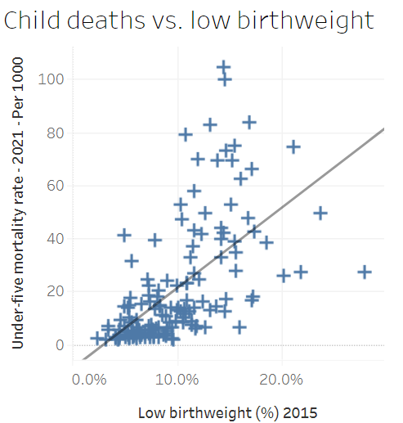
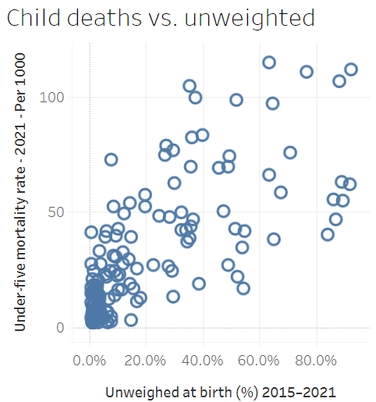
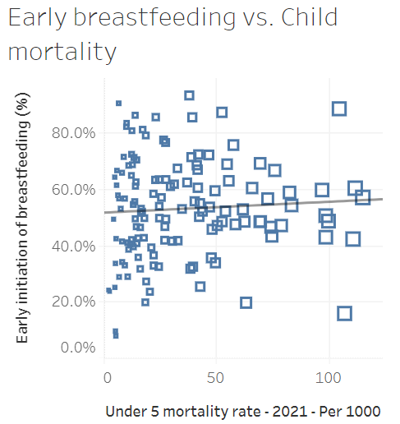
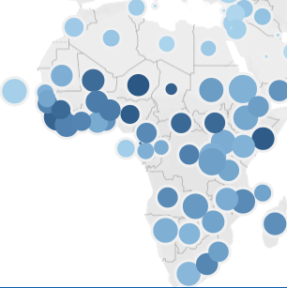
Child deaths caused by lack of nutrition
Countries where children are born underweighted have a higher child mortality
When there are more than 10 % born underweight, the child mortality distribution is higher. 10 % is a threshold
When there are less than 10 % born underweighted, child mortality tends to be lower
When children are unweighted, child mortality tends to be higher. The reason might be that babies born underweight or medical care are not on a good level.
Interestingly, the early adoption of breastfeeding doesn't affect child mortality
Breastfeeding vs. mortality map
Notes:
As we can see 10 % seems to be a threshold where more children are born underweight, these countries have a higher child mortality . Also, we can notice that if children are unweighted when they are born, those countries tend to have a higher mortality. The reason could be a lack of medical care. And lastly, the early adoption of breastfeeding doesn't correlate with child mortality.

Slide 5
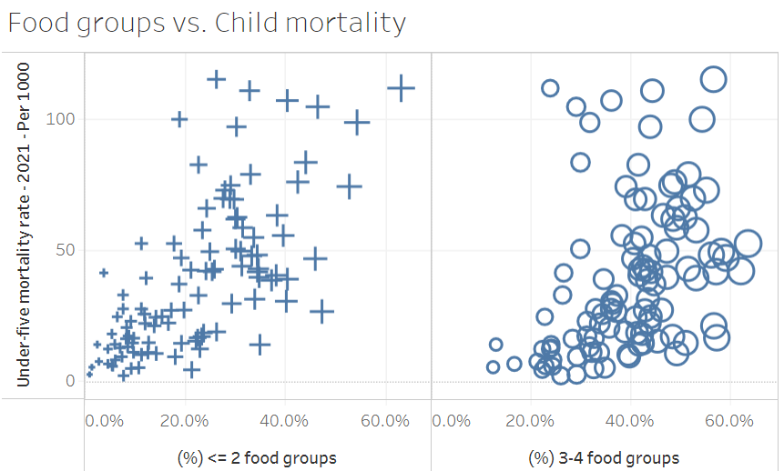
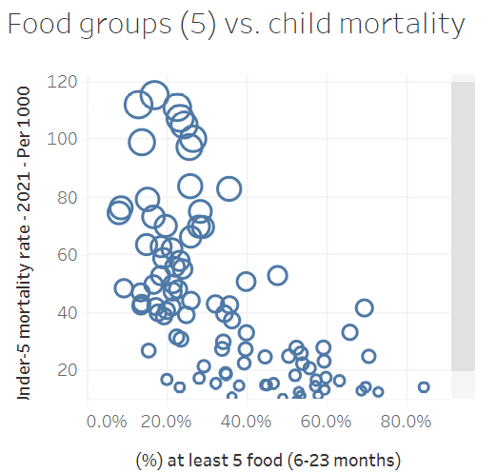
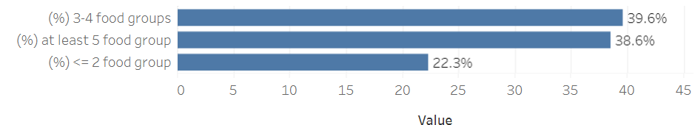
Food groups vs. Child mortality
When there are only a few food types, countries tend to have a high child mortality rate
Instead, when there are enough food types, countries tend to have a low child mortality rate
Nearly 60 percent of the children don't have enough food types available
Lack of food types seems to be a high threat to the children's
Notes:
Too few food types are a huge threat to children. As we can see 60 percent of the children don't have minimum required food types available. Those countries where there is a lack of food types have a higher child mortality. When there are enough food types available, mortality drops instantly. This is a huge threat to children.

Slide 6
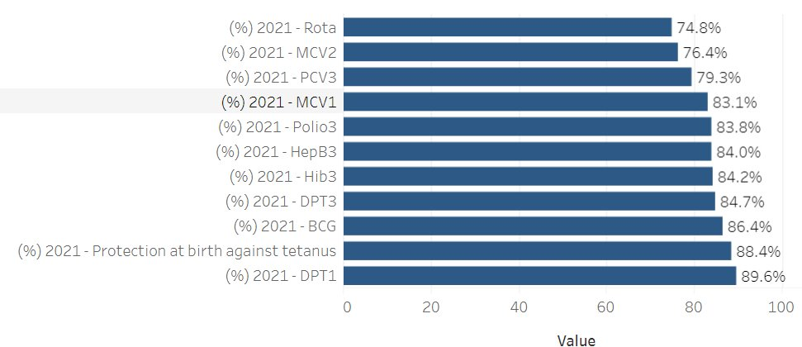
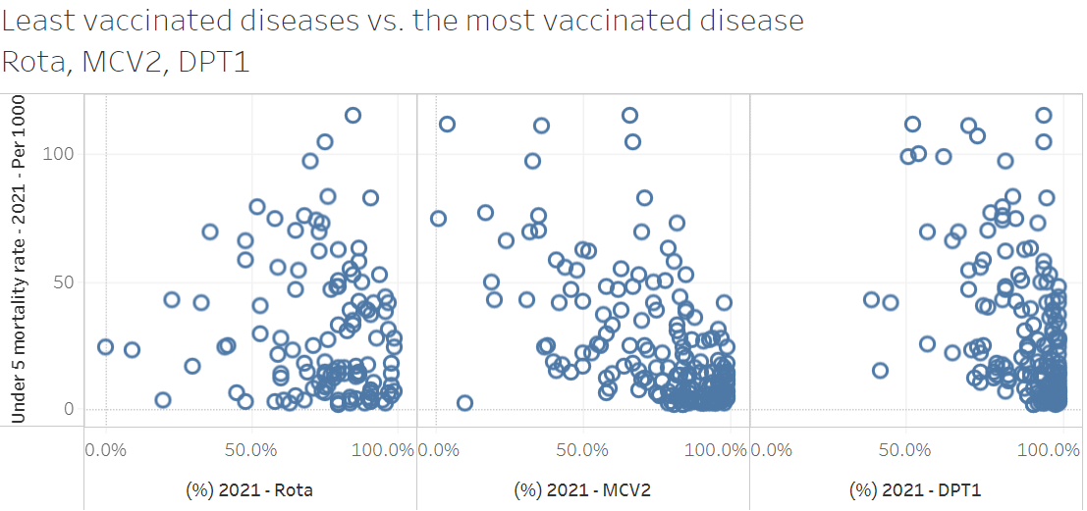
Vaccination vs. Child mortality
Children are well vaccinated against diseases
MCV2 vaccine seems to have some correlation between child mortality and the percentage of children who have this vaccine
Otherwise, there seems to be a low correlation between child vaccination and mortality. At least with the vaccines with the highest and lowest percentage
Notes:
Vaccination coverage seems to be on a good level. There seems no clear correlation between child mortality and vaccinated children. The only exception here is MCV2 where countries that have a high vaccination ratio tend to have a lower child mortality.

Slide 7
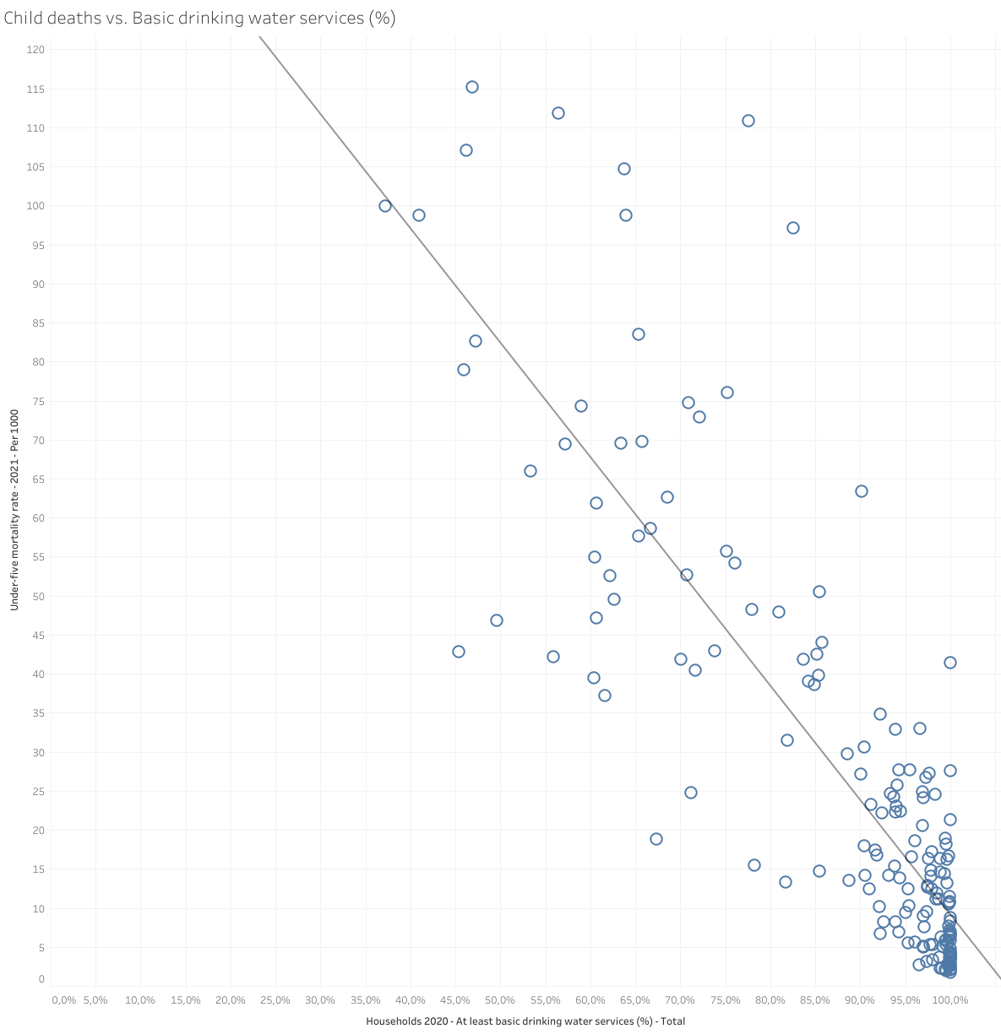
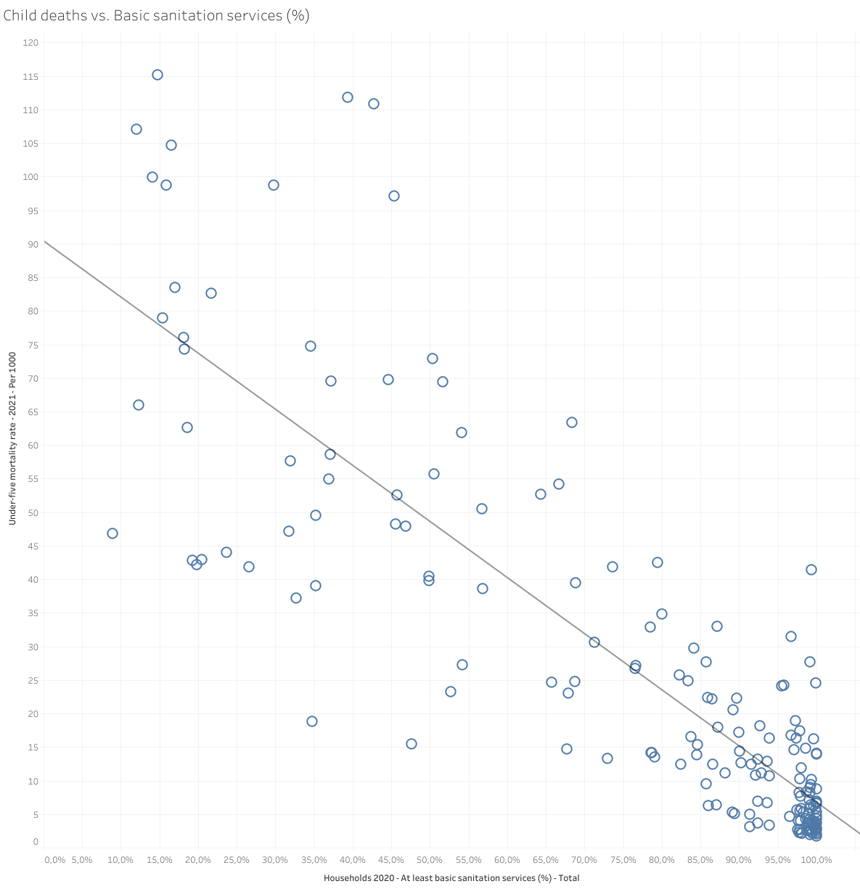
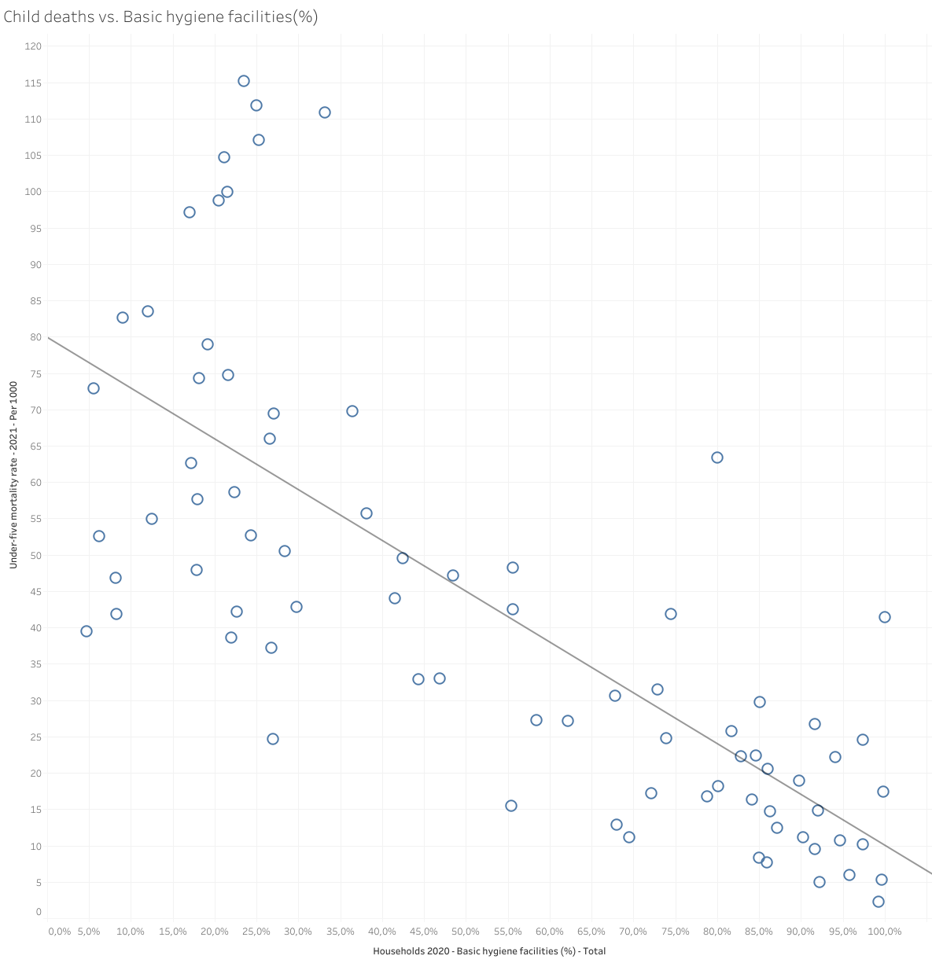
Hygiene vs. Child mortality
There is a clear correlation with hygiene standards and child mortality.
Notes:
Here, we observe the clear correlation between child mortality and hygiene factors such as drinking water, sanitation services, and hygiene facilities. This analysis utilizes data from both rural and urban households from 2020.

Slide 8
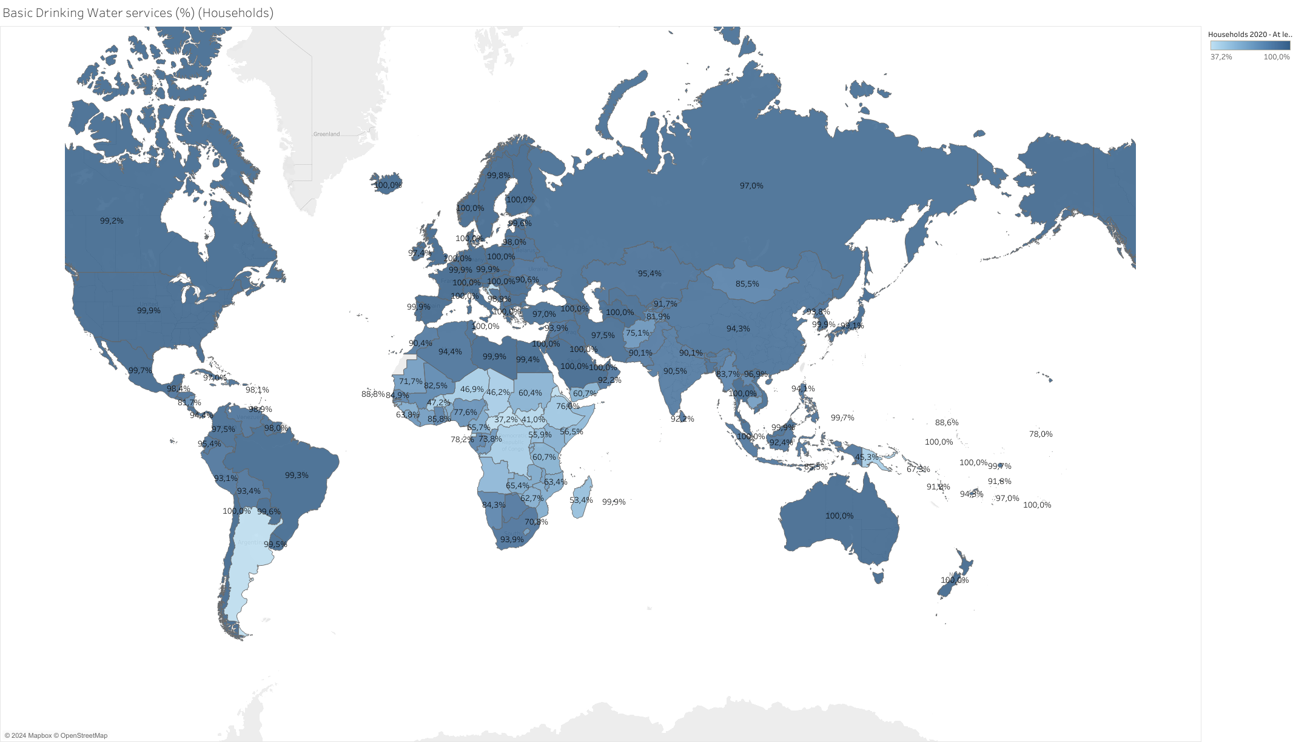
Basic Drinking Water services (%) (Households)
Basic drinking water availability has clear geographical focus near Sub-Saharan Africa.
The Sub-Saharan drinking water problems are caused by rapid population growth, poverty and climate change.
https://en.wikipedia.org/wiki/Water_scarcity_in_Africa
Notes:
Here is a map illustrating drinking water availability which reveals that Sub-Saharan Africa is facing significant challenges. These water issues, driven by rapid population growth, poverty, and climate change, pose a severe threat to the health and well-being of children in the region

Slide 9
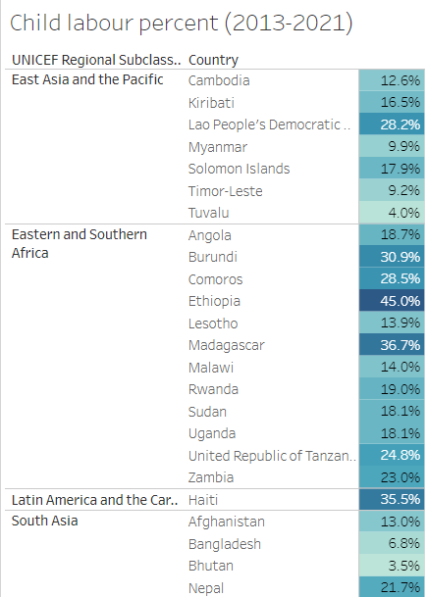
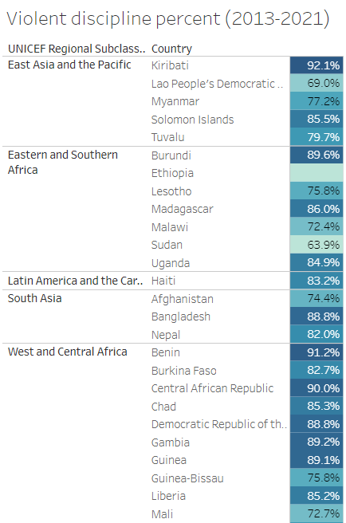
Child protection
Insights of child labor and violent discipline status can be extracted from UNICEF least developed countries.
Most of these countries have child labor over 15% and overwhelmingly high percentage (over 80%) of violent discipline (beating, insulting, humiliating)
Child mortality is higher when they are subject to hard labor and violent discipline from young age
Notes:
Finally, we observe that the least developed countries according to UNICEF has a very bad index of child labor and violent discipline, where many children are subject to early labor and beatings. Children can have higher mortality when they are treated cruelly.

Slide 10
Group X
April 2024
Notes:
In conclusion, data shows that child mortality is influenced by multiple factors, including nutrition, dietary diversity, hygiene and child abuse such as hard labor and violent discipline. Child mortality is predominantly an issue in Sub-Saharan Africa. By focusing efforts on improving nutrition and hygiene in this region, we can make a substantial impact in reducing these rates and saving lives.

Slide 11
Contributors
Name | Student number | Willing to participate in event (yes / no) | Email
Rasmus Pyykkölä | 1015191 | no | rasmus.pyykkola@aalto.fi
Tuomo Filatow | 779742 | no | tuomo.filatow@aalto.fi
Ville Mäntysalo | 799413 | no | ville.mantysalo@aalto.fi
Nguyen Xuan Binh | 887799 | no | binh.nguyen@aalto.fi
Group X
April 2024

